Slide 1
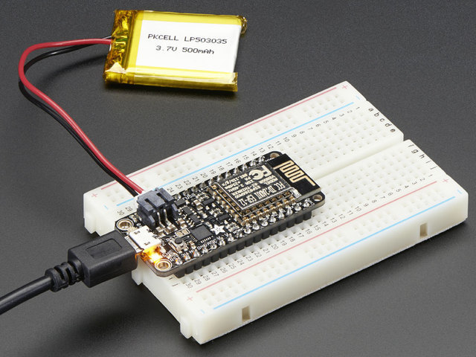
Networking with embedded systems
Adafruit Feather HUZZAH ESP8266
Used to achieve wireless communication with your robot
Standard Micro USB cable
Comes programmed with NodeMCU’s Lua, but you can use the Arduino IDE as well.

Slide 2
Node-Mcu lua-Download driver software
Use this link to download and install the necessary software so that your COM/Serial port will appear correctly
https://www.silabs.com/products/mcu/Pages/USBtoUARTBridgeVCPDrivers.aspx

Slide 3
Node-mcu lua-putty setup
If you haven’t already downloaded Putty, you can do so here:
https://www.chiark.greenend.org.uk/~sgtatham/putty/latest.html
Connect the chip to your computer with the USB Cable
Use putty to connect to the COM or Serial port your cable is connected to

Slide 4
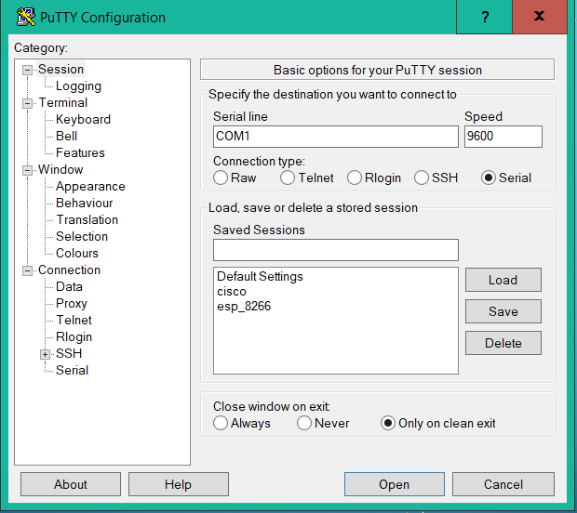
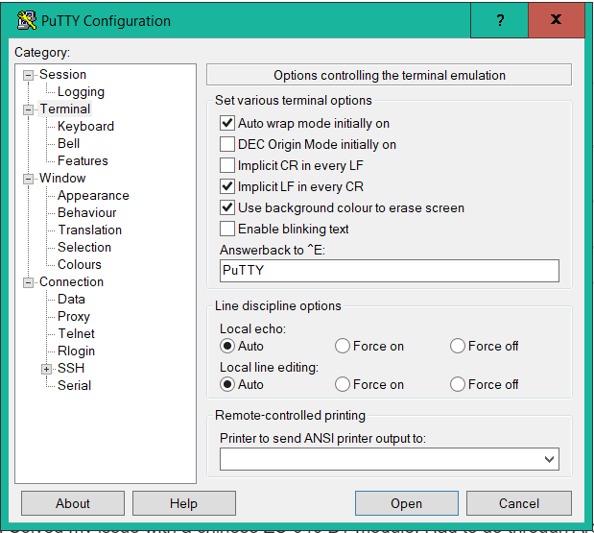

Slide 5
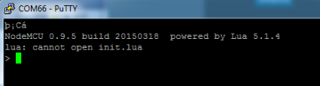
Node-mcu lua-Connecting with Putty
Once you’re connected, press the reset button on the chip.
Red and blue lights should flash
Something similar to this should be printed:

Slide 6
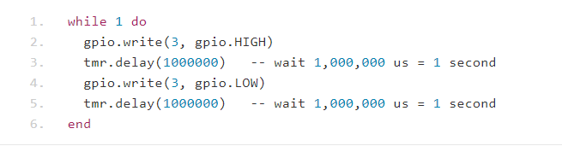
Node-mcu lua-Led blink code
You can now copy and paste code or type commands to send them to the chip.
This example code controls pin output to cause an LED to blink.
You could write similar code to control things connected to other pins.

Slide 7
Arduino ide-download software
If you’re more familiar with Arduino or C coding, you can program the chip to use that language
This will erase the NodeMCU Lua programming from the chip. You can redownload it here:
https://github.com/nodemcu/nodemcu-flasher
If you want to use the Arduino IDE and don’t have it, you can download it here:
https://www.arduino.cc/en/Main/Software

Slide 8
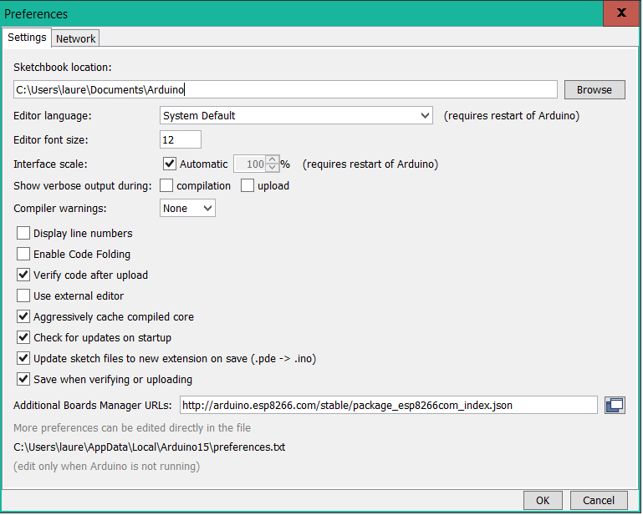
Arduino ide-adding board package
In the Arduino IDE, go to Preferences under the File tab
Paste this URL into the Additional Boards Manager URLs slot:
http://arduino.esp8266.com/stable/package_esp8266com_index.json

Slide 9
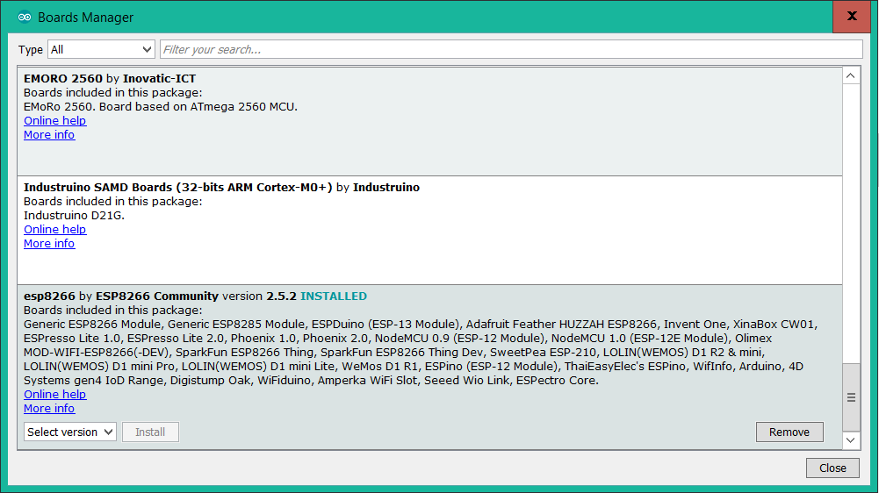
Arduino ide-installing the board package
Click on Board: under the Tools tab, and choose Board Manager
Click on the ESP8266 box, and then click Install

Slide 10
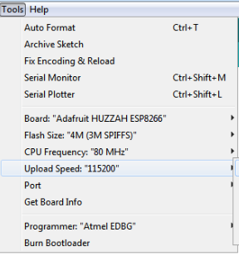
Arduino ide-board setting
Go to the tools tab, and choose Adafruit Feather HUZZAH ESP8266
Set the CPU Frequency to 80 MHz
Set the flash size to 4M(3M Spiffs)
Set the upload speed to 115200
Select the COM port that connects to your USB

Slide 11
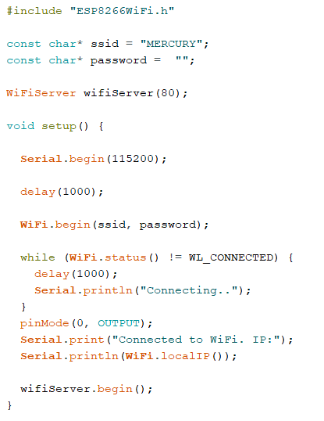
Arduino ide-socket server
At this point, you can write code and compile and upload it to the board while it’s connected via USB just like any Arduino code
To communicate wirelessly, you need a socket server
Use code from one of a number of sources to create one

Slide 12
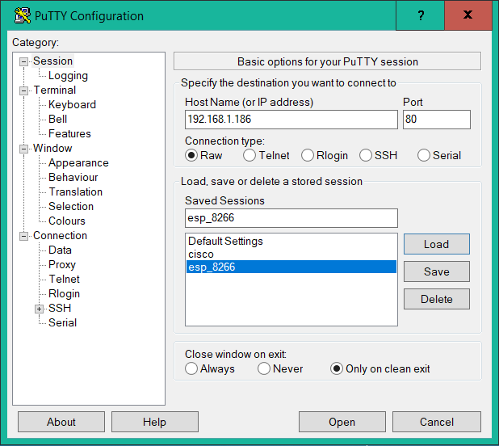
Arduino ide-putty settings
Once the Webserver code is uploaded to the chip, go to the Arduino IDE’s serial monitor under tools.
The IP Address of the chip should be printed in the serial monitor once connected.
Use this address to connect to the chip with Putty, on port 80

Slide 13
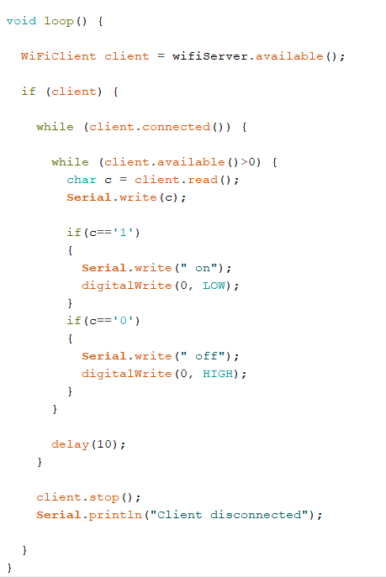
Arduino ide-led control example
Any commands entered in the Putty window will be sent to the chip and processed within the code
Add code to process input data and control pin output to make the chip respond to certain inputs
Here, sending 1 in Putty turns the LED on, 0 turns it off

Slide 14
References
This code can be generalized to send information to any of the chip’s pins, and control any part of a robot.
For more information:
https://techtutorialsx.com/2018/06/02/esp8266-arduino-socket-server/
https://learn.adafruit.com/adafruit-feather-huzzah-esp8266/overview

